Slide 1
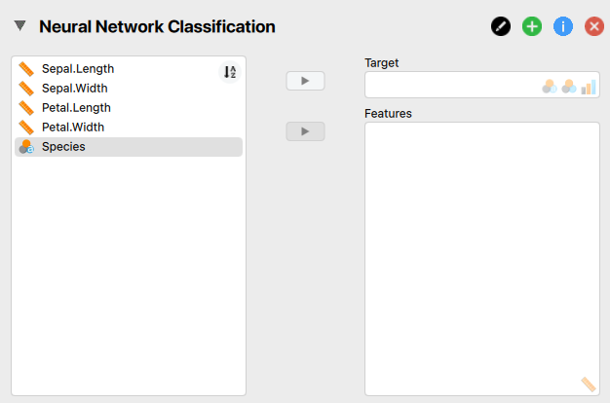

JASP – IRIS data
Ground Truth
Data Feature

Slide 2
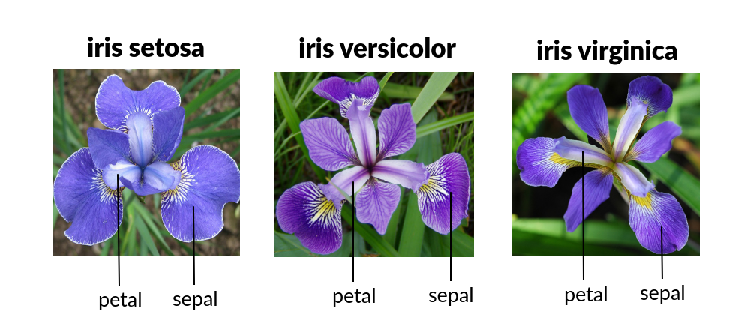
IRIS Dataset

Slide 3
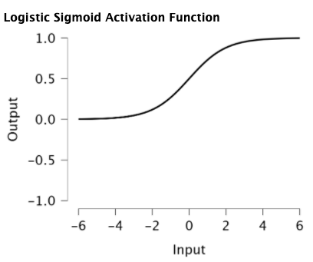
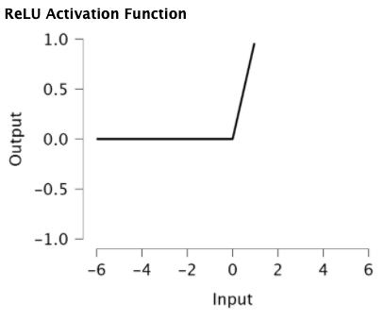
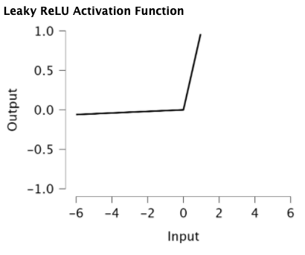
JASP – train parameter
Algorithmic Settings (init set: Logistic sigmoid)
Activation function
Selection total layer nonlinear activation
Linear activation can’t use in backpropagation model.

Slide 4
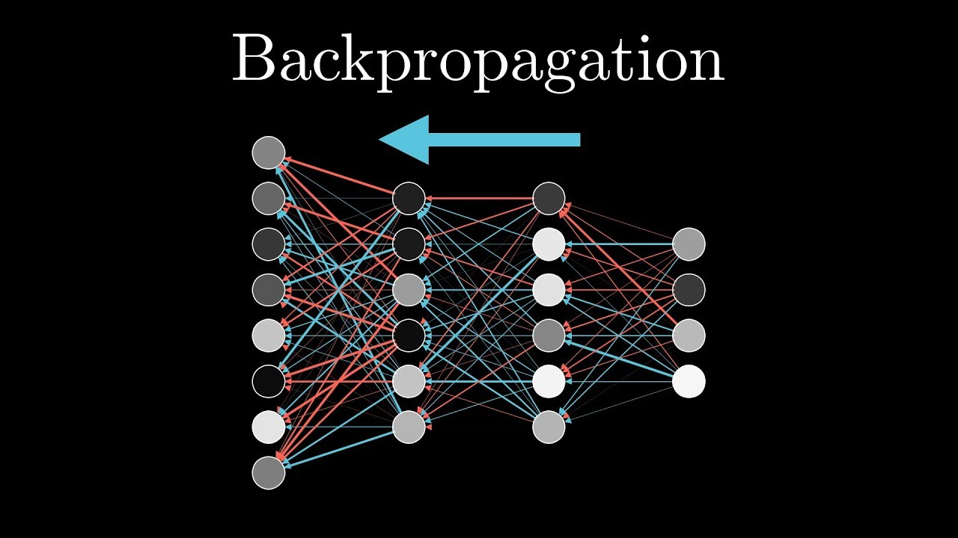
JASP – train parameter
Algorithm
Backpropagation
Resilient Backpropagation(Rprop +/-)
'rprop+' and 'rprop-' refer to the resilient backpropagation with and without weight backtracking.
The gradient will be updated positively or negatively
smallest absolute gradient (sag) or the smallest learningrate (slr)
'sag' and 'slr' induce the usage of the modified globally convergent algorithm (grprop).

Slide 5
JASP – train parameter
Learning rate [0.1 - 0.009]
Parameter settings affect the algorithm
Only can set in backpropagation algorithm
Stopping criteria loss function (init set: 1)
The threshold for the partial derivatives of the error function as stopping criteria
Max.training repetitions (init set: 10000)
Set experiment epoch numbers

Slide 6
JASP – train parameter
Scale features
Data normalization
Set seed
Control model initialization weight

Slide 7
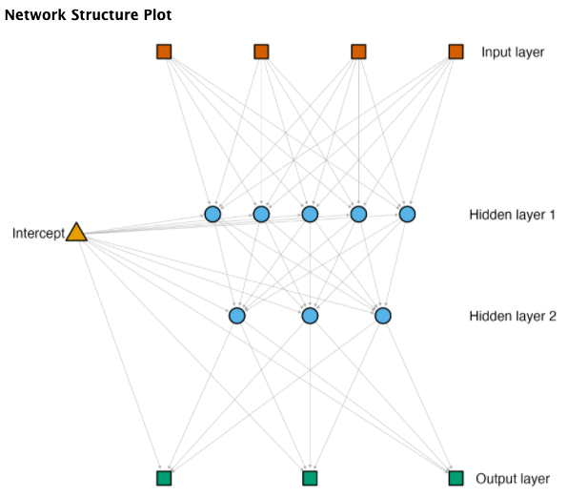
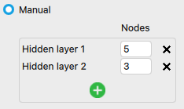
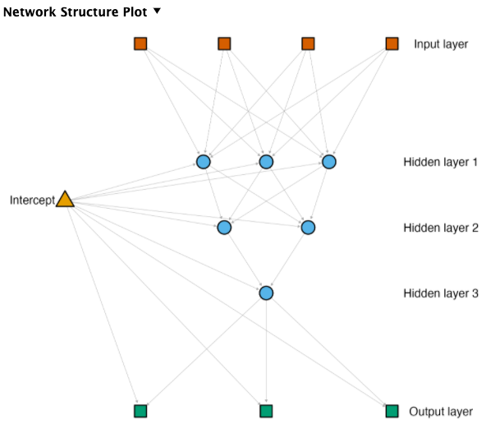
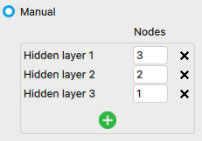
JASP – model parameter
Network Topology
Manual
Setting model hidden layer
Set fully-connected layer numbers
Nodes Numbers
Set single layer unit numbers

Slide 8
JASP – model parameter
Optimized (Genetic Algorithm)
Population size
Set random numbers group of parameter for neural network
Parent selection
Set how many groups the GA must select
Crossover method

Slide 9
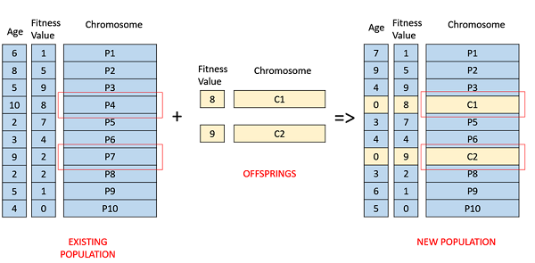
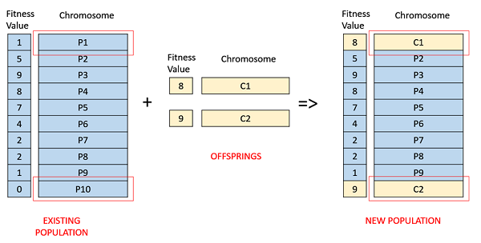
JASP – model parameter
Optimized (Genetic Algorithm)
Mutations
Probability – Reset, Swap, Scramble, Inversion
Mutating is required to maintain some amount of randomness in the GA.
Survival method
Fitness-based
Age-based
Elitism
Set child’s chose proportion

Slide 10
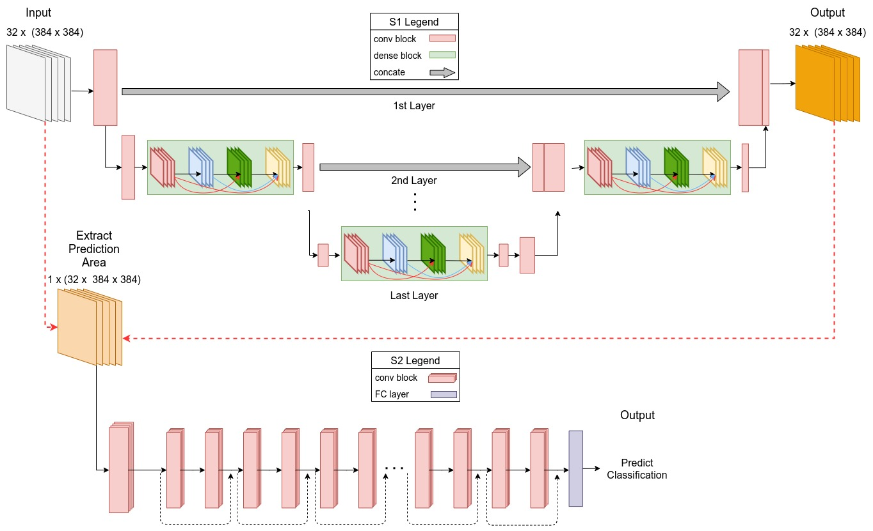
SGD Net –Model Architecture
Toward Explainable Semantic Segmentation Guided Detector for Segmentation and Classification of Diffusion-Weighted MRI of Acute Ischemic Stroke

Slide 11
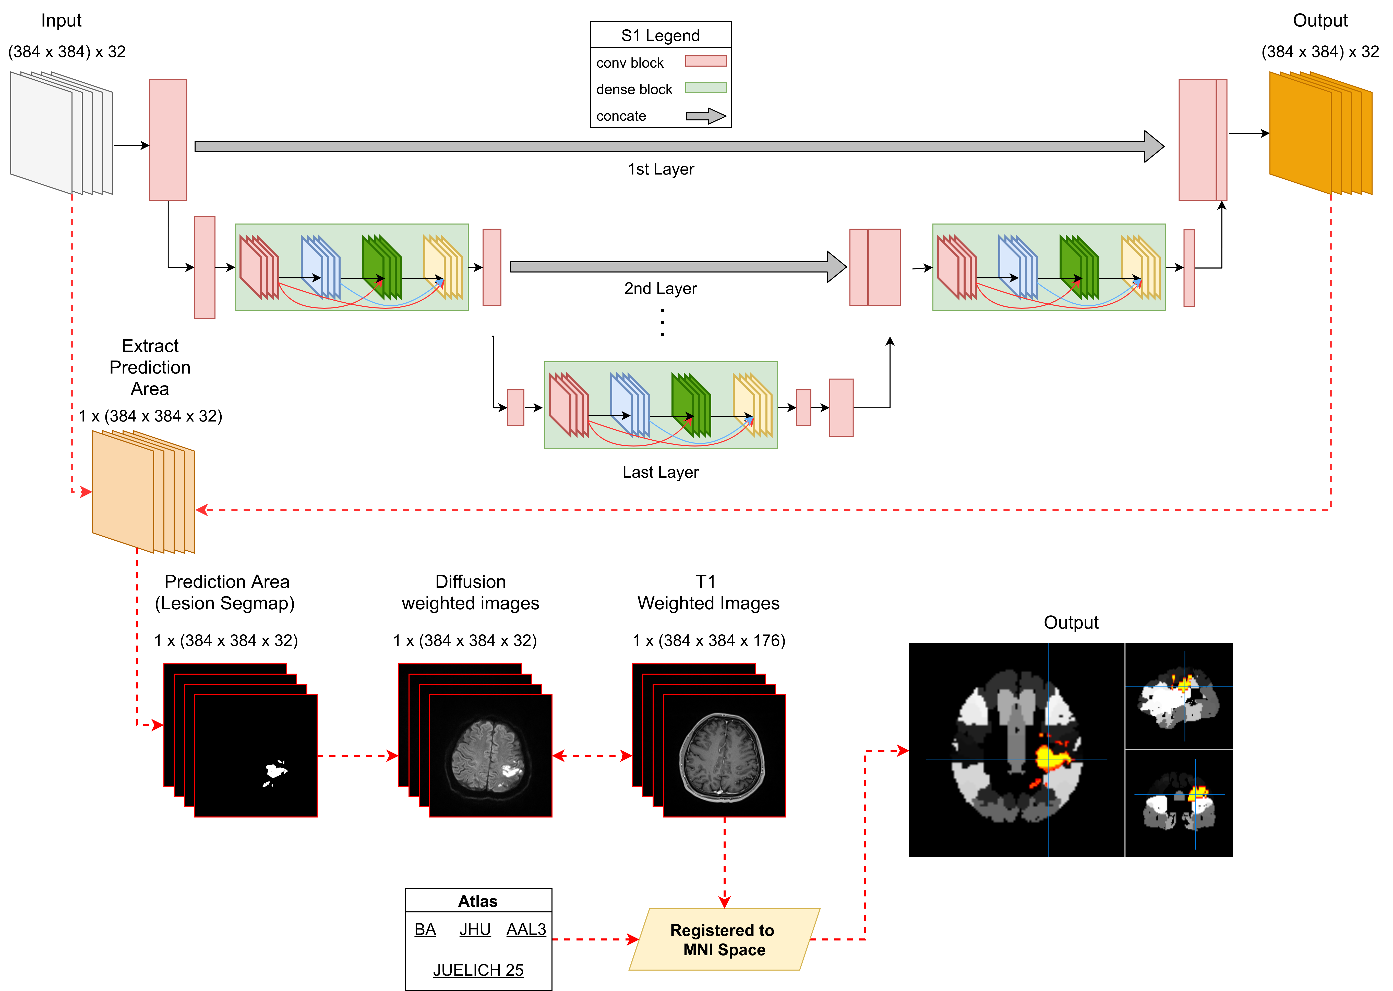
SGD Net Atlas –Model Architecture

Slide 12
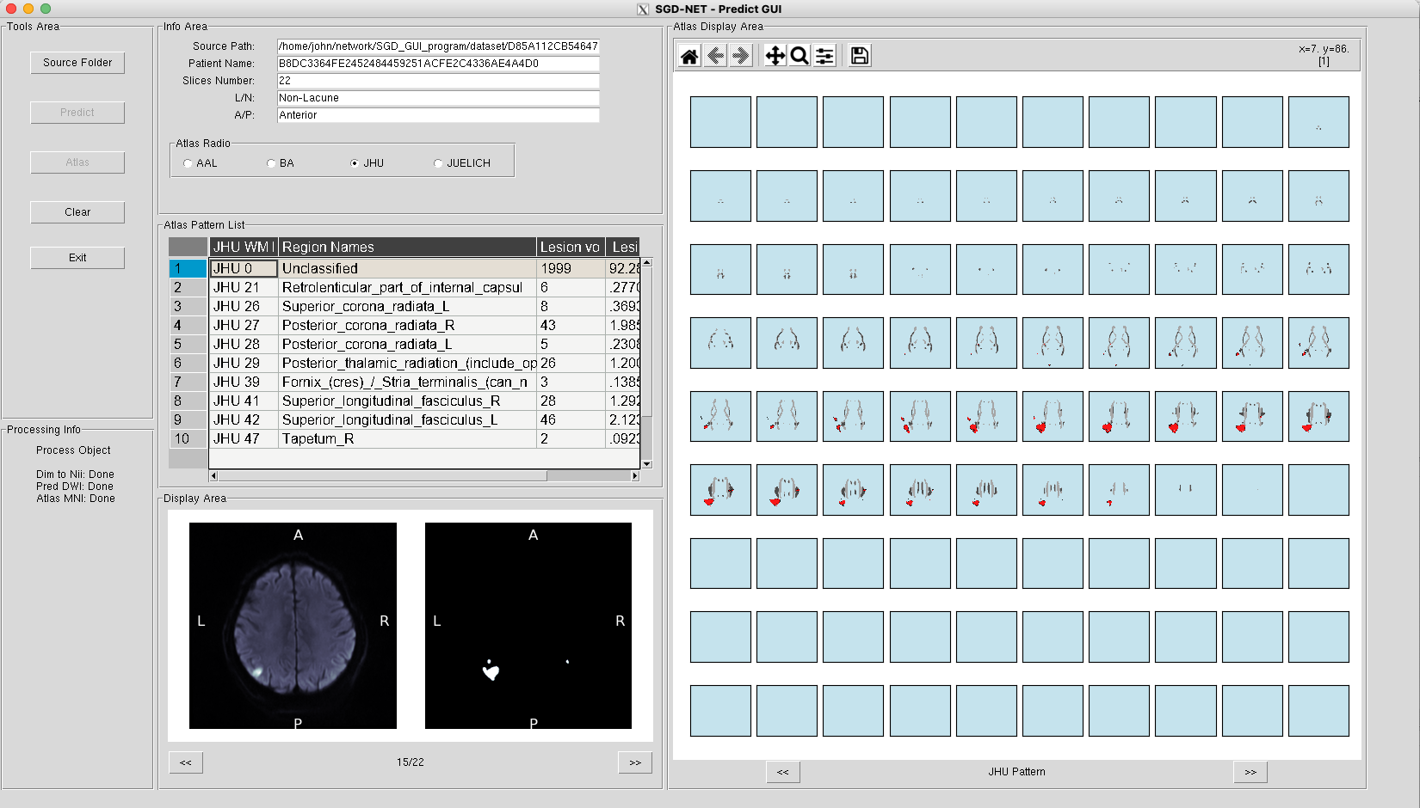
SGD Net – GUI Program

